Slide 1
CS 4530: Fundamentals of Software Engineering Module 09: React Hook Patterns
Adeel Bhutta, Joydeep Mitra and Mitch Wand
Khoury College of Computer Sciences
© 2025 Released under the CC BY-SA license
Notes:
Welcome to Module09: React Hooks. Hooks are a unique feature of REACT, which enable React components to deal with inputs other than mouse clicks and the like.

Slide 2
Learning Objectives for this Module
By the end of this module, you should be able to:
Explain the basic use cases for useEffect
Explain when a useEffect is executed, and when its return value is executed
Construct simple custom hooks and explain why they are useful.
Be able to explain the three core steps of a test (assemble, act, assess) can map to UI component testing
Notes:
<read slide>

Slide 3
Lesson 9.1 useEffect
Notes:
David Khourshid (Microsoft developer) said that perhaps ‘useEffect’ should have been called ‘useSynchronize’

Slide 4
useEffect is a mechanism for synchronizing a component with an external system
import { clockServer } from './clock.js';
function ClockClient() {
useEffect(() => {
const connection = clockServer.createConnection()
connection.connect();
return () => {
connection.disconnect();
};
}, []);
// ...
}
Action to take on first render
Action to take when component dismounts
Empty array says: do this on first render only
https://react.dev/reference/react/useEffect
Notes:
The fundamental job of useEffect is to coordinate your component with some system external to REACT. Here’s an example, where we want to connect to an imaginary external clock. Let's look at the different pieces of the useEffect.
<click>
First is the dependency array. This controls when the useEffect is executed. Here we've put in an empty array, which specifies that this useEffect is to be run on the first render only. There are other possibilities, which we'll talk about later.
<click>
Next is the hook function. This is the function that is run when the useEffect is executed-- in this case, on the first render. Here, we create a connection to the external clock.
<click>
Last is the cleanup function. In the useEffect design, this is the value returned by the hook function-- look at the 'return'. Because this hook is run only when the component mounts, the cleanup function is run only when the component dismounts. In this case, the cleanup function releases the connection to the external clock. This is the polite thing to do, as it eliminates possible resource leaks. We'll talk about other possibilities later.
Did you notice that this example is unrealistic? Why do you think so? <Ans: no way for the rest of the component to refer to the connection>. We'll study a working example in a minute.

Slide 5
An external system means any piece of code that’s not inside your React component
An event in the lifecycle of a component, like redisplay.
A timer managed with setInterval and clearInterval
An event subscription like a chat server (sockets?)
A call to fetch data from an external API or web site
An external animation library
A piece of business logic in an app that is external to your component
Notes:
What do we mean by an "external system"? <read slide>

Slide 6
A real example: a display that connects to a self-ticking clock
src/app/Components/SimpleClockDisplay.tsx
export default function ClockDisplay(props: {
name: string, key: number,
clock:IClock,
handleDelete: () => void,
handleAdd: () => void,
})
{
const [localTime, setLocalTime] = useState(0)
const incrementLocalTime = () => setLocalTime(localTime => localTime + 1)
const clock = props.clock
useEffect(() => {
const listener1 = () => { incrementLocalTime() }
clock.addListener(listener1)
return () => {
clock.removeListener(listener1)
}
}, [])
The parent provides the clock
On first render, add this listener to the clock
On dismount, remove the listener.
Display logic will come later…
Notes:
Here's a real example. We build a listener. Then, the first time this component is displayed, we add this listener to the clock, thereby connecting the component. The rest of the component can see the local time by checking the 'localTime' variable.
When the component dismounts, we tell the clock to release the listener.

Slide 7
Our app will have three displays of the clock
src/Apps/ThreeClocks/App.tsx
import * as React from 'react'; import { useState } from 'react'; import ClockDisplay from '../../Components/ClockDisplay'
import SingletonClock from '../../Classes/SingletonClockFactory' function doNothing() { }
export default function App() { const [clock, _] = useState(SingletonClock.getInstance(1000));
return (
<VStack>
<ClockDisplay key={1} name={"Clock A"} clock={clock}
handleAdd={doNothing}handleDelete={doNothing}
/>
<ClockDisplay key={2} name={"Clock B"} clock={clock}
handleAdd={doNothing} handleDelete={doNothing}
/>
<ClockDisplay key={3} name={"Clock C"} clock={clock}
handleAdd={doNothing} handleDelete={doNothing}
/>
</VStack>
);
}
Notes:
Let's look at this in action.
<Demo> Observe that the clocks agree about the time and they count by themselves.
Let’s see how this is accomplished.

Slide 8
Next, let’s look at the clock
src/Classes/SingletonClockFactory.ts
type Listener = () => void
class Clock implements IClock{
private _listeners: Listener[] = []
private _notifyAll() {this._listeners
.forEach(eachListener => {eachListener()})}
public addListener(listener: Listener) {---}
public removeListener(listener: Listener) {---}
get nListeners () {return this._listeners.length}
private _timer : NodeJS.Timeout
private _interval : number
public id : string
public constructor(interval: number) {
this.id = nanoid(4)
this._interval = interval;
this.start()
}
public start() {
console.log(`Clock ${this.id} starting`)
this._timer = setInterval(() => {
this._tick();
}, this._interval);
}
private _tick() {
this._notifyAll();
}
public stop() {
console.log(`Clock ${this.id} stopping`)
clearInterval(this._timer);
}
}
Notes:
Our clock will use a listener pattern. In this version of the pattern, the listener is a function that takes no arguments and returns void. Presumably calling a listener has some side-effect. This clock is very bare-bones: it doesn’t even keep track of the time itself: It just calls all its listeners every `interval` milliseconds.
In the OO world, this organization of a listener is sometimes called a “delegate”.

Slide 9
We’ll make the clock a singleton in the usual way
src/Classes/SingletonClockFactory.ts
export default class SingletonClockFactory {
private static theClock: Clock | undefined = undefined
private constructor () {SingletonClockFactory.theClock = undefined}
public static instance (interval:number) : Clock {
if (SingletonClockFactory.theClock === undefined) {
SingletonClockFactory.theClock = new Clock(interval)
}
return SingletonClockFactory.theClock
}
}
Notes:
We'll make the clock into a singleton, just like we did back in Module 05.

Slide 10
Let's look at <ClockDisplay> again
src/Components/SimpleClockDisplay.tsx
export default function ClockDisplay(props: {
name: string; key: number; clock: IClock;
handleDelete: () => void; handleAdd: () => void;
}): JSX.Element {
const [localTime, setLocalTime] = useState(0);
const incrementLocalTime = () => { setLocalTime((localTime) => localTime + 1); };
const listener1 = () => { incrementLocalTime(); };
const clock = props.clock;
useEffect(() => {
clock.addListener(listener1);
console.log(`ClockDisplay ${props.name} is mounting`);
return () => {
console.log("ClockDisplay " + props.name + " is unmounting");
clock.removeListener(listener1);
};
}, []);
business logic
Notes:
Here we create a listener, which, when called, increments the local time. Following the pattern on Slide 5, we use `useEffect` to add the listener to the clock when the page first mounts, and we remove it when the page dismounts. We'll also add some log commands so we can watch it in the browser console.
ClockDisplay takes props for handleDelete and handleAdd, but <ClockDisplayApp> provides them with a function that does nothing. So the trash can and the little plus sign don’t do anything right now.

Slide 11
ClockDisplay, part 2: the display logic
function handleStop() { clock.stop(); } function handleStart() { clock.start(); }
return (
<HStack>
<Box>Clock: {props.name}</Box>
<Box>Clock ID: {clock.id} </Box>
<Box>Time = {localTime}</Box>
<Box>nlisteners = {clock.nListeners}</Box>
<Button aria-label={"start"} onClick={handleStart}>Start</Button>
<Button aria-label={"stop"} onClick={handleStop}>Stop</Button>
<IconButton aria-label={"delete"} onClick={props.handleDelete}
icon={<AiOutlineDelete />}
/>
<IconButton aria-label={"add"} onClick={props.handleAdd}
icon={<AiOutlinePlus />}
/>
</HStack>
);
display logic
Notes:
And finally, here's where the display is actually generated. We have an hstack that shows the clock's name, its local time, a button for asking its parent to delete it, and a button for asking its parent to create a new clockdisplay.

Slide 12
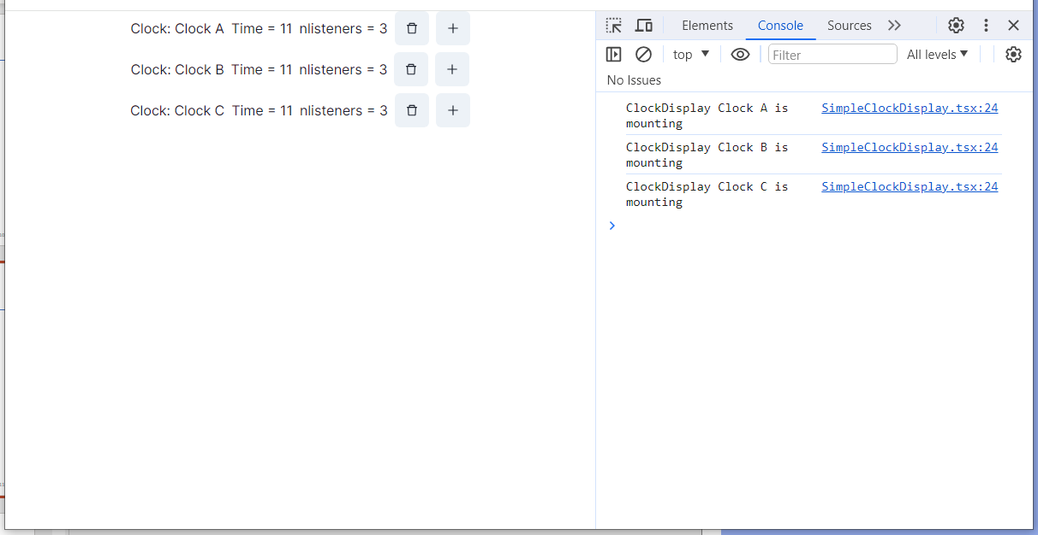
running SimpleClockDisplayApp
Notes:
Here we went to localhost:3000, started the console with C-S-I, and hit "reload" to get the display from the beginning.
We can't do anything else with this app right now, but we'll come back to it a little later.

Slide 13
useEffect’s Dependencies Control Its Execution
useEffect takes an optional array of dependencies
The effect is only executed if one or more of the values in the dependency change (e.g. by a setter)
Special Cases:
[] means run only on first render
No argument means run on every render
Notes:
Next, let's look at the dependency array in more detail. <read slide>

Slide 14
Example (Part 1)
src/app/Apps/useEffect-demo.tsx
export default function App() {
const [n, setN] = useState(0)
const [m, setM] = useState(0)
// runs only on first render.
useEffect(() => {
console.log('useEffect #1 is run only on first render')}, [])
useEffect(() => {
console.log('useEffect #2N is run only when n changes')}, [n])
useEffect(() => {
console.log('useEffect #2M is run when m changes')}, [m])
useEffect(() => {
console.log('useEffect #2MN is run when m or n changes')
}, [m,n]
// runs on every render
useEffect(() => {
console.log('useEffect #3 is called on every render')})
// observe that effects run in order of definition
Notes:
Here's an example with two state variables, n and m, and a bunch of useEffects, with different dependency arrays. The log messages tell us when each of the useEffects run:
useEffect #1 has an empty dependency array, so it is run only on first render
useEffect #2N has a dependency array with just n, so it is run only when n changes.
useEffect #2M has a dependency array with just m, so it is run only when m changes.
useEffects #3A, B and C (on next slide) have no second argument, so they are run on every render. We'll see that these are run in the order they appear in the file.
NOTE: when you load the component, these hooks may run twice in development mode (npm run dev), but they will only run once on subsequent redisplays, and (most importantly) in production.

Slide 15
Example (part 2)
function onClickN() {
console.log('Clicked n!');
setN(n => n + 1);
}
function onClickM() {
console.log('Clicked m!');
setM(m => m + 1);
}
return (
<VStack>
<Heading>useEffect demo #1</Heading>
<Text> n is {n} </Text>
<Button onClick={onClickN}>Increment n</Button>
<Text> m is {m} </Text>
<Button onClick={onClickM}>Increment m</Button>
</VStack>
}
Notes:
We'll create two buttons, each of which increments n or m, and logs itself in the console.
Let's watch.
<Demo; display console with Control-I>

Slide 16
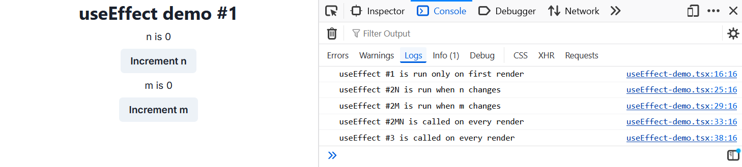
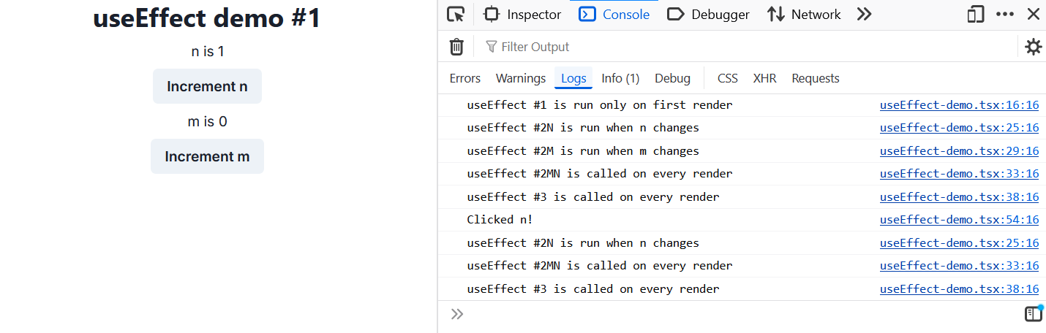
Demo
Notes:
<explain slide, or demo & explain as you go>

Slide 17
When is the cleanup function executed?
In general, the cleanup function is executed sometime before the next time the hook is run.
For the first-time-only case, this means when the component is dismounted.
Let's look at useEffect demo again, this time with noisy cleanups.
Notes:
<Read slide>
<Demo: Apps/ArrayOfClocksApp.tsx >
Observe that the number of listeners is decremented whenever you delete a clock display.
This tells us that the cleanup code is running. And you can watch this in the console log also.
Let's look at the code for this:

Slide 18
src/Apps/useEffect-demoWithCleanUps.tsx
function cleanup(message: string) {return () => {console.log('cleanup: ' + message)}}
export default function App() {
const [n, setN] = useState(0)
const [m, setM] = useState(0)
useEffect(() => {
console.log('useEffect #1 is run only on first render')
return cleanup('useEffect #1')
}, [])
useEffect(() => {
console.log('useEffect #2N is run only when n changes')
return cleanup('useEffect #2N')
}, [n])
... // other effects
Notes:
Here we've taken our useEffect demo and instrumented it to make the execution of the cleanup functions visible.
To do this, we've defined a function `cleanup` that takes a string and returns a 0-argument function that is suitable to use as a return value from useEffect.
Then we've taken each useEffect and modified it to return a suitably labelled cleanup function.
Last, we've modified the "Increment n" and "Increment m" buttons to log a message to the console when they are clicked (not shown on slide).
Let's watch this in action

Slide 19
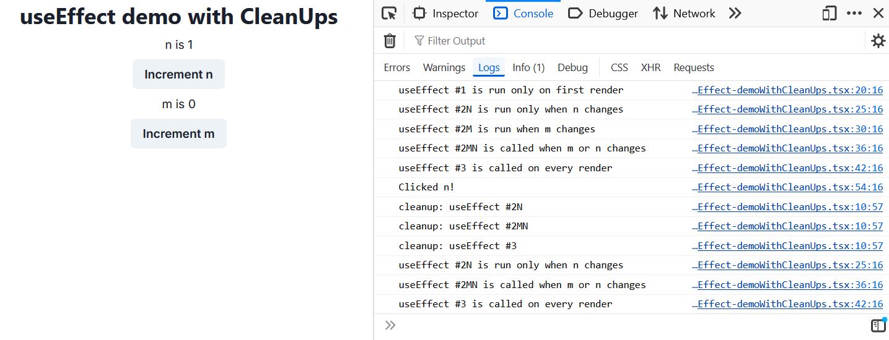
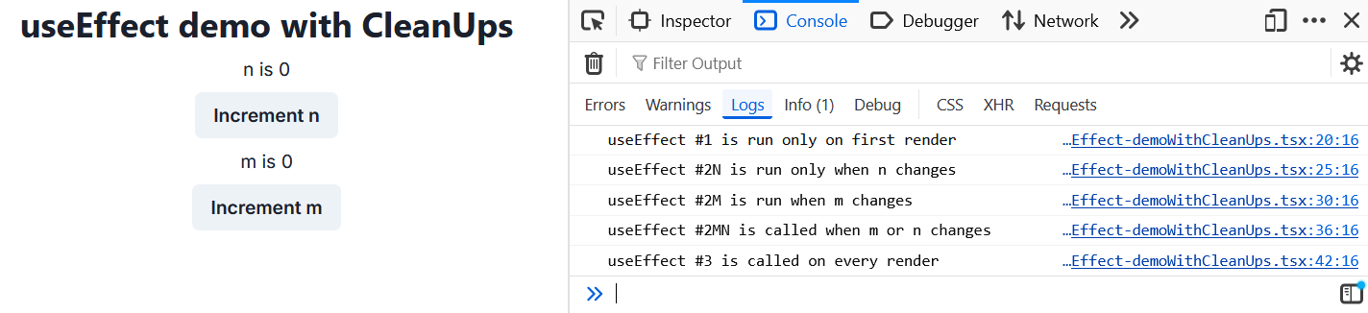
Notes:
Here we've hit Reload. Observe that effects #1, 2N, 3A, and 3B are run.
Then we clicked 'n'.
We will need to run 2N, 3A, and 3B again. So first, the cleanups for 2N, 3A, and 3B are run, and then 2N, 3A, and 3B are run.
(As we said, the cleanups are guaranteed to be run before the next execution of the useEffect).
What about useEffect #1, which is only run on the first render. We could create an example that would demonstrate that, but it would take more effort to create and explain than it would be worth ☺

Slide 20
Communication with an (Actual) External System
In the previous example, everything was present in the one codebase, including the clock.
More common situation is that the user interface components need to communicate with a remote system, not necessarily in the same codebase.

Slide 21
useEffect and and fetch working together
// the value of globalCount will be passed to the children
const [globalCount, setGlobalCount] = useState(0);
const [sumLocalCounts, setSumLocalCounts] = useState(0);
const [localCountA, setLocalCountA] = useState(0);
const [localCountB, setLocalCountB] = useState(0);
// when either local count changes, recalulate the sum
useEffect(() => {
recalculateGlobalCount();
}, [localCountA, localCountB]);
async function recalculateGlobalCount() {
console.log("recalculating");
const response = await fetch(`/sum/${localCountA}/${localCountB}`);
const sum = await response.json();
console.log("sum", sum);
setGlobalCount(sum.sum);
setSumLocalCounts(localCountA + localCountB);
return;
}

Slide 22
Lesson 9.2 Custom Hooks

Slide 23
Custom Hooks
REACT lets us combine useState and useEffect to build custom hooks.
Custom Hooks let us separate business logic from display logic
Notes:
<Read slide>

Slide 24
Example: useClock
export function useClock (listener1: () => void) : IClock {
const clock = SingletonClockFactory.getInstance(1000)
useEffect(() => {
clock.addListener(listener1)
return () => {
clock.removeListener(listener1)
}
}, []);
return clock
}

Slide 25
Using useClock
src/Components/SimpleClockDisplayWithUseClock.tsx
import { useClock } from '../Hooks/useClock';
export function ClockDisplay(props: {
name: string, key: number,
handleDelete: () => void, handleAdd: () => void,
noisyDelete?: boolean
}) {
const [localTime, setLocalTime] = useState(0)
const incrementLocalTime = () => setLocalTime(localTime => localTime + 1)
const clock:IClock = useClock(incrementLocalTime)
return (
<HStack>
<Box>Clock: {props.name}</Box>
<Box>Time = {localTime}</Box>
<Box>nlisteners = {clock.nListeners}</Box>
<IconButton aria-label={'delete'} onClick={props.handleDelete} icon={<AiOutlineDelete />} />
<IconButton aria-label={'add'} onClick={props.handleAdd} icon={<AiOutlinePlus />} />
</HStack>
)
}
Notes:
Here’s our old friend ClockDisplay, but this time using useClock. We take advantage of the fact that useClock returns the clock so that we can refer to clock.nListeners, (or start and stop the clock, if that affordance is available) from the client.
/** this para only applies if we get starting and stopping working
Note that if we have several components (as in ArrayOfClocksApp), stopping or starting the clock in one component will start or stop it in all of them.
*/
More complicated hooks might return more complicated objects. For example, covey.town makes extensive use of a hook called useTown that returns the town in which some component is running.

Slide 26
A somewhat larger example: ToDoList
src/Apps/ToDoApp/App.tsx
export default function ToDoApp () {
const [todoList,setTodolist] = useState<ToDoItem[]>([])
const [itemKey,setItemKey] = useState<number>(0) // first unused key
function handleAdd (title:string, priority:string) {
if (title === '') {return} // ignore blank button presses
setTodolist(todoList.concat({title: title, priority: priority, key: itemKey}))
setItemKey(itemKey + 1)
}
function handleDelete(targetKey:number) {
const newList = todoList.filter(item => item.key != targetKey)
setTodolist(newList)
}
return (
<VStack>
<Heading>TODO List</Heading>
<ToDoItemEntryForm onAdd={handleAdd}/>
<ToDoListDisplay items={todoList} onDelete={handleDelete}/>
</VStack>
)
}
business logic
display logic

Slide 27
Refactoring ToDoList
src/Apps/ToDoAppWithCustomHooks/App.tsx
business logic is encapsulated
export default function ToDoApp () {
const {todoList, handleAdd, handleDelete} = useToDoItemList()
return (
<VStack>
<Heading>TODO List</Heading>
<ToDoItemEntryForm onAdd={handleAdd}/>
<ToDoListDisplay items={todoList} onDelete={handleDelete}/>
</VStack>
)
}

Slide 28
The hook encapsulates the business logic
src/Apps/ToDoAppWithCustomHooks/useToDoItemList.tsx
export default function useToDoItemList () {
const [todoList,setTodolist] = useState<ToDoItem[]>([])
const [itemKey,setItemKey] = useState<number>(0) // first unused key
function handleAdd (title:string, priority:string) {
if (title === '') {return} // ignore blank button presses
setTodolist(todoList.concat({title: title, priority: priority, key: itemKey}))
setItemKey(itemKey + 1)
}
function handleDelete(targetKey:number) {
const newList = todoList.filter(item => item.key != targetKey)
setTodolist(newList)
}
return {todoList: todoList, handleAdd: handleAdd, handleDelete: handleDelete}
}

Slide 29
The hook is like a class managing a piece of state
export default function useToDoItemList () {
const [todoList,setTodolist] = useState<ToDoItem[]>([])
const [itemKey,setItemKey] = useState<number>(0) // first unused key
function handleAdd (title:string, priority:string) {
if (title === '') {return} // ignore blank button presses
setTodolist(todoList.concat({title: title, priority: priority, key: itemKey}))
setItemKey(itemKey + 1)
}
function handleDelete(targetKey:number) {
const newList = todoList.filter(item => item.key != targetKey)
setTodolist(newList)
}
return {todoList: todoList, handleAdd: handleAdd, handleDelete: handleDelete}
}
handleAdd and handleDelete are the only methods for manipulating the state

Slide 30
The hook's state becomes part of its user's state.
export default function useToDoItemList () {
const [todoList,setTodolist] = useState<ToDoItem[]>([])
const [itemKey,setItemKey] = useState<number>(0) // first unused key
function handleAdd (title:string, priority:string) {
if (title === '') {return} // ignore blank button presses
setTodolist(todoList.concat({title: title, priority: priority, key: itemKey}))
setItemKey(itemKey + 1)
}
function handleDelete(targetKey:number) {
const newList = todoList.filter(item => item.key != targetKey)
setTodolist(newList)
}
return {todoList: todoList, handleAdd: handleAdd, handleDelete: handleDelete}
}
calling these setters redisplays the whole component

Slide 31
The Rules of Hooks
Only call hooks at the top level
Not within loops, inside conditions, or nested functions
Rationale: The order of hooks called must always be the same each time a component renders
Only call hooks from React Components or Custom Hooks
Not from any other helper methods or classes
Rationale: React must know the component that the call to the hook is associated with
export function LikeButton(){
const [isLiked, setIsLiked] = useState(false);
const [count, setCount] = useState(0);
...
}
React knows which useState is which by tracking calls to them from components in the render tree
Notes:
There are two rules of hooks, both of which are necessary for React to uniquely identify calls to hooks across different renders of the same component.
(Read slide)

Slide 32
We Use Two ESLint Rules for React Hooks
You should not violate the rules of hooks. These linter plugins help detect violations
React-hooks/rules-of-hooks
Enforces that hooks are only called from React functional components or custom hooks
React-hooks/exhaustive-deps
Enforces that all variables used in useEffects are included as dependencies
Notes:
That is the end of Module 8, Part 1. In Part 2, we'll talk about how one could use automated testing on components of React and similar systems.

Slide 33
Putting it All Together
In the previous examples, we learned
how to introduce side effects
how to create our own hooks
We can use these concepts to make React components interact with a remote system (e.g., REST services).

Slide 34
Interacting With a REST-based Server
client/src/hooks/useAnswerPage.ts in ip2 codebase
/**
* Custom hook for managing the answer page's state, navigation, and real-time updates.
*
*/
const useAnswerPage = () => {
const { qid } = useParams();
const navigate = useNavigate();
const { user, socket } = useUserContext();
const [questionID, setQuestionID] = useState<string>(qid || ‘’);
const [question, setQuestion] = useState<PopulatedDatabaseQuestion | null>(null);
Notes:
The example is a snippet from a custom hook in the ip2 starter code: The hook is responsible for retrieving answer-related data from the answer REST service.
This slide shows the state variables used to manage the component where the hook will be used
Next slide shows how the effect is added to interact with the external answer service

Slide 35
Interacting With a REST-based Server
useEffect(() => {
/**
* Function to fetch the question data based on the question ID.
*/
const fetchData = async () => {
try {
const res = await getQuestionById(questionID, user.username);
setQuestion(res || null);
} catch (error) {
console.error('Error fetching question:', error);
}
};
fetchData().catch(e => console.log(e));
}, [questionID, user.username]);
Async call to REST service
Run effect only when questionID and username changes
Notes:
The effect is inside the custom hook. It makes a call to a async function that connects to the REST service.
The effect does not run on every render, but only when the variables in the dependency array change.
Notice the catch block with fetchData(). Ask why is it written that way? - because fetchData() returns a promise.

Slide 36
Interacting With a REST-based Server
/**
* Function to get a question by its ID.
*
* @param qid - The ID of the question to retrieve.
* @param username - The username of the user requesting the question.
* @throws Error if there is an issue fetching the question by ID.
*/
const getQuestionById = async (
qid: string,
username: string,
): Promise<PopulatedDatabaseQuestion> => {
const res = await api.get(`${QUESTION_API_URL}/getQuestionById/${qid}?username=${username}`);
if (res.status !== 200) {
throw new Error('Error when fetching question by id’);
}
return res.data;
};
Notes:
This is the function that actually calls the REST API
This is the same function that was called from the useEffect in the custom hook

Slide 37
Interacting With a REST-based Server
/**
* AnswerPage component that displays the full content of a question along with its answers.
* It also includes the functionality to vote, ask a new question, and post a new answer.
*/
const AnswerPage = () => {
const { questionID, question, handleNewComment, handleNewAnswer } = useAnswerPage();
if (!question) {
return null;
}
return (
<>
<VoteComponent question={question} />
<AnswerHeader ansCount={question.answers.length} title={question.title} />
Custom hook being used.
Notes:
- The example shows a snippet from the component that uses the custom hook.
- The custom hook defines the effect that calls the REST service for answers.

Slide 38
Lesson 9.3 Testing your REACT components

Slide 39
Testing React components
The AAA pattern ("Assemble/Act/Assess") still applies
Need a test double for the React system
render components into a "virtual dom" or into a captive web browser
The FakeStackOverflow codebase uses Cypress, a popular tool for end-to-end testing.
“Testing Library” https://testing-library.com is another test system for React. It is compatible with many UI libraries and many testing frameworks
https://docs.cypress.io/guides/end-to-end-testing/writing-your-first-end-to-end-test
Notes:
We can test React components by building a test double for the react system. The test double render scomponents into a "virtual dom" just like the browser's DOM. We can interact with the test by firing events just like a user would, and then we should be able to inspect the virtual DOM to see what happened.
This can all be done using a package called "testing-library", which is compatible not only with React and Jest, but with many UI libraries and testing frameworks.

Slide 40
Cypress commands work on a "virtual DOM"
.visit() | Visit a remote URL. Many tests begin with this command.
.contains() | Select a DOM element by text content.
.get() | Find DOM elements by selector
.click() | Click a DOM element.
.type() | Type into a DOM element.
These will fail if the specified element does not exist
https://docs.cypress.io/api/table-of-contents#Cypress-API

Slide 41
Recall: Most tests are in AAA form: Assemble/Act/Assess
test('addStudent should add a student to the database', () => {
// const db = new DataBase ()
expect(db.nameToIDs('blair')).toEqual([])
const id1 = db.addStudent('blair’);
expect(db.nameToIDs('blair')).toEqual([id1])
});
Assemble (and check that you’ve assembled it correctly)
Act (do the action that you are trying to test)
Assess: check to see that the response is correct
Notes:
Remember this example from Module 3: <review text if needed>
In order to run a test, we need to first ASSEMBLE it. This may include creating instances of classes/variables, setting up test data for inputs, etc. We should always check to see that we’ve set it up correctly. In this example most of the work has already been done in a beforeEach block (not shown here)
Then we ACT: we do the action under test.
Last, we ASSESS: we check to see that the response was acceptable. In Jest, this is done by the expect function; in other testing frameworks this is called assert. Note that the test uses some methods other than the one we’re testing; we’ll write tests for nameToIDs separately.
Another way of looking at this is that this test is not just about addStudent; it’s making sure that addStudent and nameToIDs cooperate (or conspire) together to produce the desired behavior.

Slide 42
A typical cypress test
testing/cypress/e2e/addAnswer.cy.ts
(from IP2 starter)
it("5.1 | Created new answer should be displayed at the top of the answers page", () => {
const answers = [
"Test Answer 1",
A1_TXT,
A2_TXT,
];
cy.visit("http://localhost:3000");
cy.contains(Q1_DESC).click();
cy.contains("Answer Question").click();
cy.get("#answerUsernameInput").type("joym");
cy.get("#answerTextInput").type(answers[0]);
cy.contains("Post Answer").click();
cy.get(".answerText").each(($el, index) => {
cy.contains(answers[index]);
});
cy.contains("joym");
cy.contains("0 seconds ago");
});
Assemble (and check that you’ve assembled it correctly)
Act (do the action that you are trying to test)
Assess: check to see that the response is correct
run with: npx cypress run

Slide 43
Learning Objectives for this Lesson
By the end of this lesson, you should be able to:
Explain the basic use cases for useEffect
Explain when a useEffect is executed, and when its return value is executed
Construct simple custom hooks and explain why they are useful.
Be able to explain the three core steps of a test (assemble, act, assess) can map to UI component testing

